Slide 1






Supriya
HOSPITAL MANAGEMENT

Slide 2
Student information
STUDENT NAME:V S Supriya REGISTER NO AND
NMID:5F05A7C79C20473E636DDD357 DEPARTMENT:BSC CS
COLLEGE:Sri Devi arts and science college UNIVERSITY:MADARS UNIVERSITY

Slide 3






Project title:
Hospital management system

Slide 4
AGENDA
problem statement
project overview
End user
Tools and technologies 5.portfolio design and layout
6.Features and layout
7.Result and screenshot 8.conclusion
9.Github link

Slide 5





Problem
statement
Health in the hospital environment means providing care, treatment, and support to people who are sick, injured, or in need of medical help. Hospitals are special places where health professionals work together to help patients feel better and recover. They play an important role in keeping the community healthy.

Slide 6


project overview
Keeping the hospital clean and safe is one of the most important parts of healthcare. Clean equipment, hand washing, and proper waste disposal help stop the spread of germs. Safety rules also protect patients and staff from accidents or injuries.

Slide 7




End user
Physical health
Emotional health
All of these areas work together to improve patient outcomes.
Preventive health

Slide 8




Tool and technologies
Hospitals have many professionals like doctors, nurses, technicians, and cleaners. Each person plays a key role in caring for patients. Good teamwork, clear communication, and respect among staff help hospitals run smoothly and provide quality care.

Slide 9






Portfolio design and
layout
Taking care of patients means more than just giving medicine. It includes listening to their needs, explaining treatments clearly, and making sure they feel comfortable. A caring attitude helps patients feel safe and supported during their recovery.

Slide 10


Features and functionality
Hospitals use technology like digital records, X-rays, and monitors to diagnose and treat patients better. These tools help doctors understand what’s happening in the body and find the best solutions quickly and safely.

Slide 11

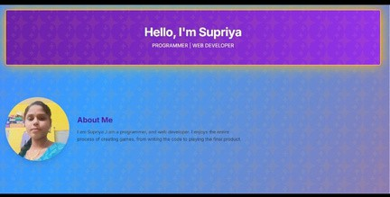
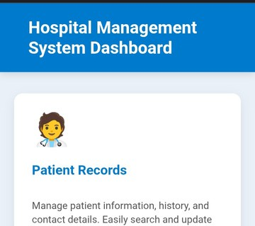



result and screenshot

Slide 12


ccoonncclluussiioonn
*improved efficiency
Automates hospital operations like patient registration, appointment,and billing

Slide 13
GitHub: link:https://github.com/vssupriya24129bsccs-ship-it/Supriya-.git

